Slide 1
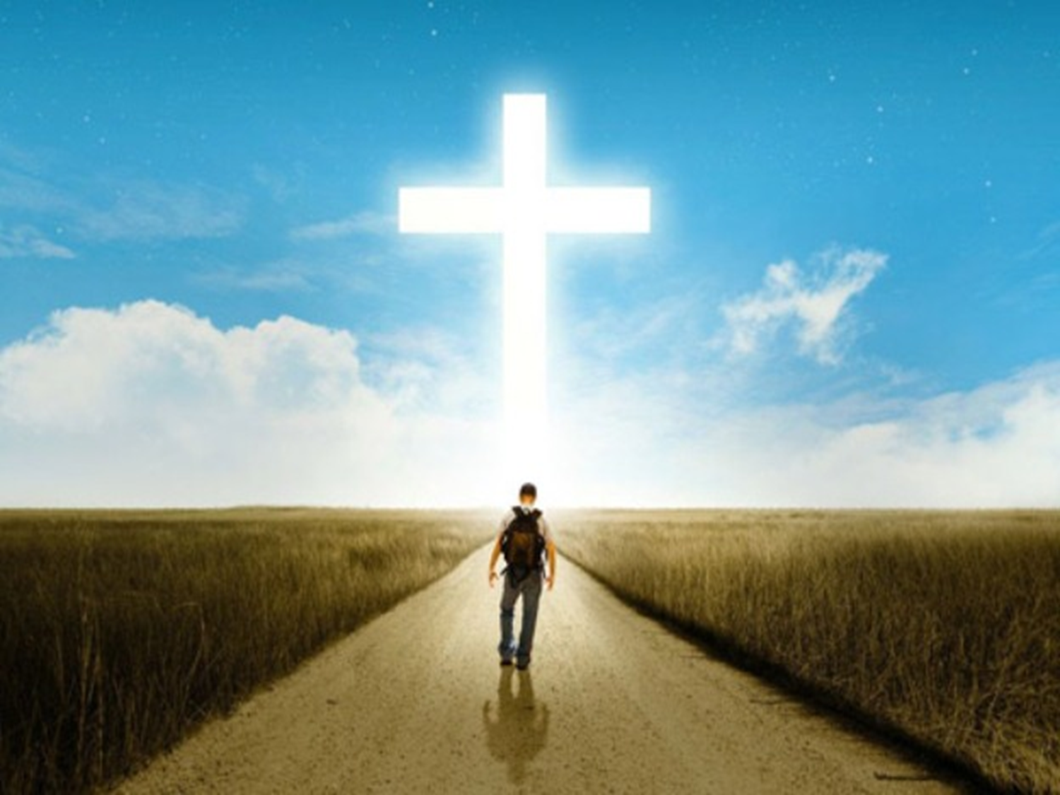
Called to be FAITHFUL!
2 Timothy 4:6-8
Pastor Rod M. Lago

Slide 2
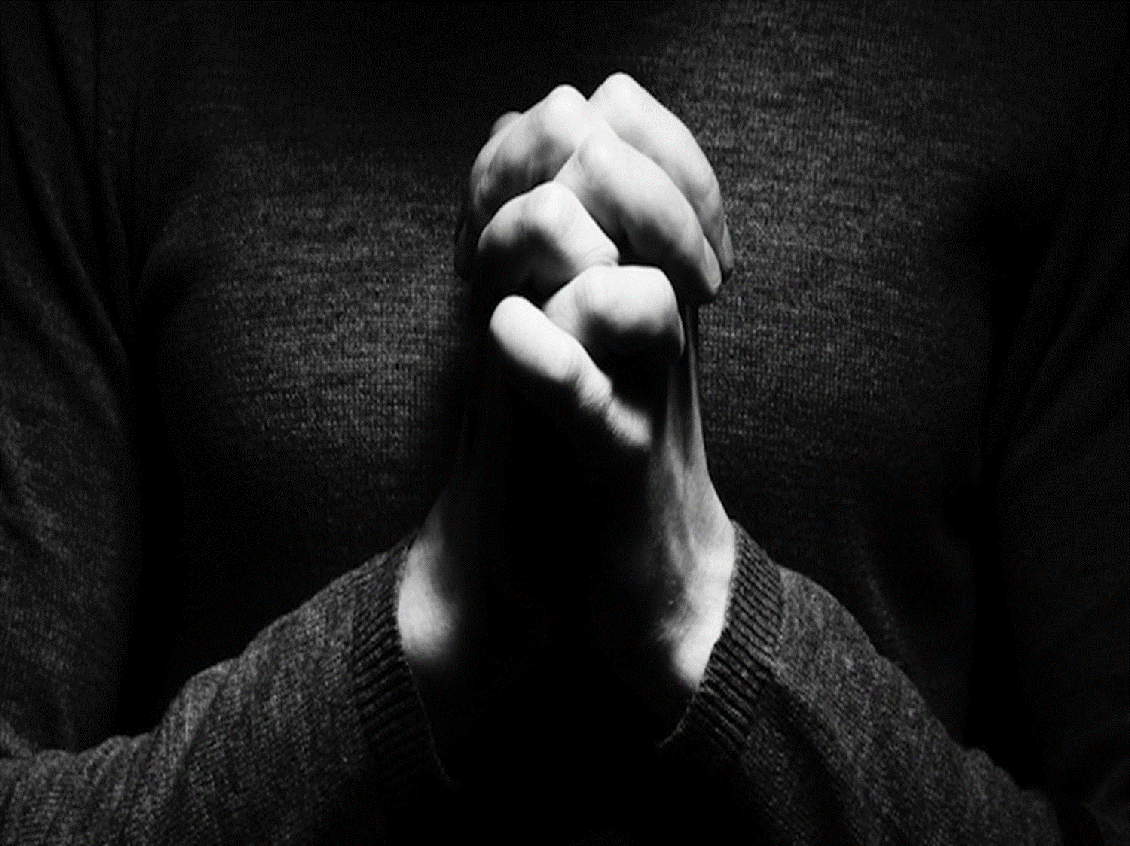
I. Paul was a Faithful Fighter.
It means He never wasted his life in serving the Lord.
It means He never give up in serving the Lord.

Slide 3

II. Paul was a Faithful Runner.
It means He never wasted his time in serving the Lord.
It means He Out stripped all his Competitors.

Slide 4
III. Paul was a Faithful Keeper of Faith.
A. It means He followed all the rules of the game and have won the prize lawfully and wholeheartedly.

Slide 5
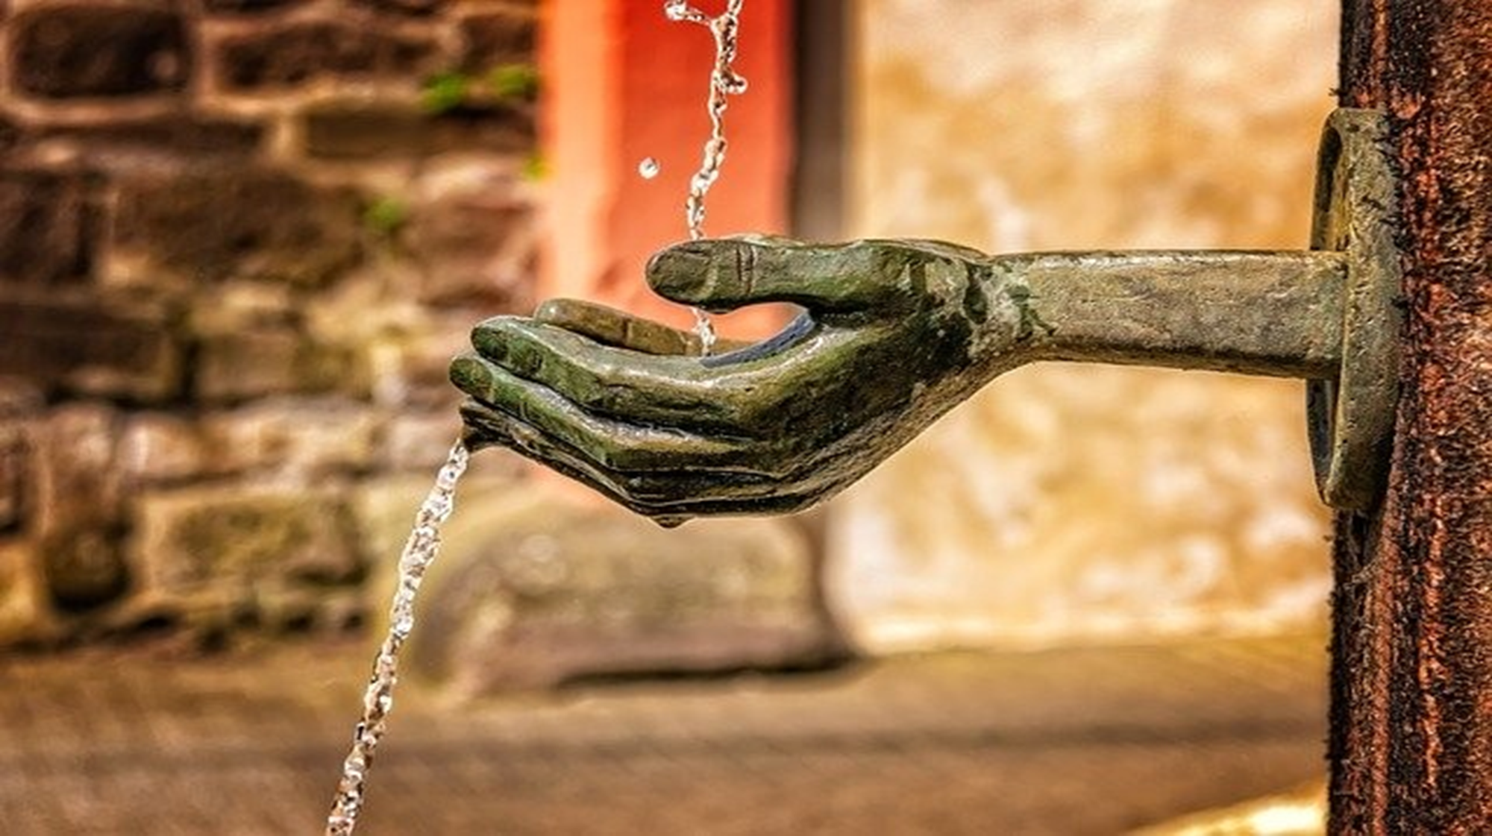
“WE NEED TO BE FAITHFUL TILL THE END BECAUSE THERE IS A REWARDS AWAITS FOR US.”

